Slide 1
LECTURE 8
TRANSIMISSION MEDIA
CONTINUED

Slide 2
OPTICAL FIBERS

Slide 3
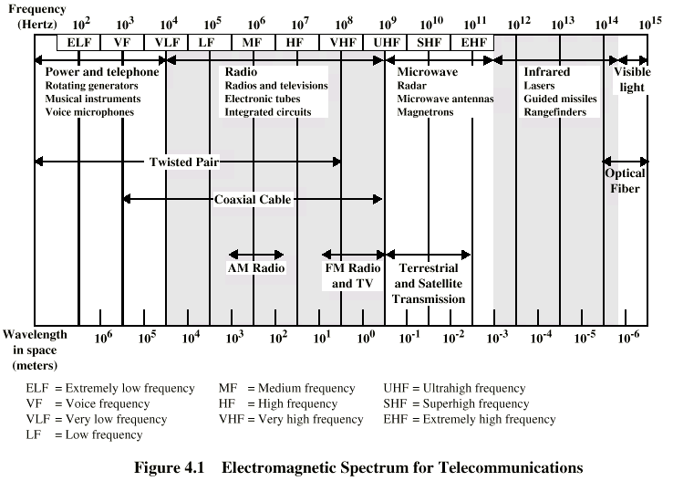

Slide 4
For a While recall:
1- Rarer medium & Denser Medium
2- Refraction of Light
3- Laws of Refraction of Light
4- Snells Law
5- Total Internal Reflection
6- Index of Refraction
7- Glass Slab Experiment

Slide 5
What is an Optical Fiber?
An optical fiber is a waveguide for light
consists of :
core inner part where wave propagates
cladding outer part used to keep wave in core
buffer protective coating
jacket outer protective shield

Slide 6

Thin glass/plastic fiber carries light with
encoded data
Plastic jacket allows fiber to bend (some!) without breaking
Fiber is very clear and designed to reflect light internally for efficient transmission
Light emitting diode (LED) or laser injects light into fiber
Light sensitive receiver or Detector ( photo diode). at other end translates light back into data

Slide 7
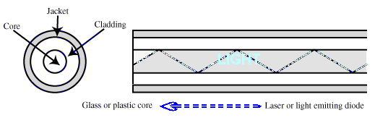

Slide 8
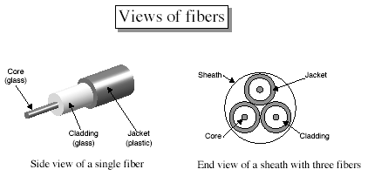

Slide 9
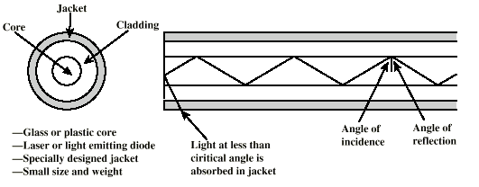
Optical Fiber
Breakthrough in data transmission systems!
Core: Thin strands of glass
Cladding: Glass with different optical properties than core
Jacket: Plastic/Insulation

Slide 10
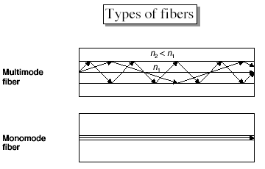

Slide 11
Types of Fibers
n_{c}
step-index
multimode
n_{f}
n_{c}
step-index
singlemode
n_{c}
n_{f}
n_{c}
n_{c}
GRIN
n_{f}
n_{c}

Slide 12
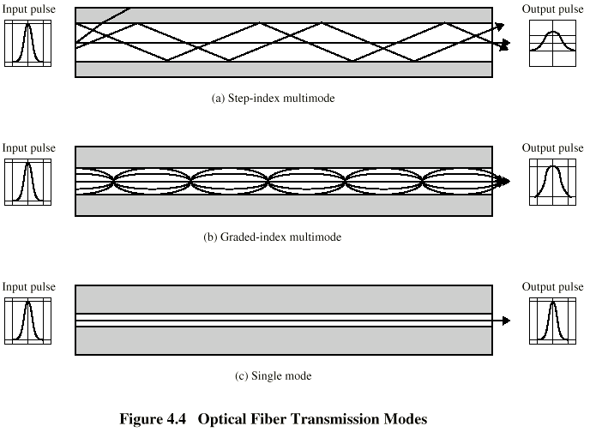
Optical Fiber Transmission Modes
LED source emits rays in all directions. Thus different rays are incident on the core opening at different incident angles. Rays at shallow angles reflect; take multiple propagation paths, each ray may take different propagation time.
Gradient refraction in core allows light to curve helically, more coherent at end
Shrink core to allow only a single angle or mode, light reflect in only one pattern

Slide 13
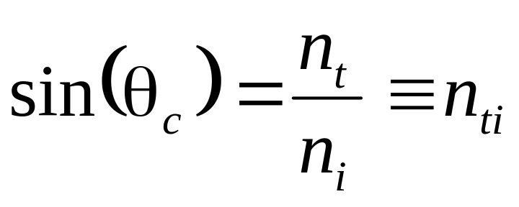
Step Index Fiber
escapes core (freedom!)
cladding
n_{t}
escapes core (freedom!)
core
n_{i}
stuck in core
θ_{i}
θ_{i}
θ_{i}
θc critical angle
θ_{i} ≥ θ_{c} for TIR (Total Internal Reflection)

Slide 14


Three examples of a light ray
from inside a silica fiber impinging on the air/silica boundary at different angles.
Light trapped by total internal reflection

Slide 15
Construction of Multimode Step Index Fiber
1- Core dia greater than 50 micron
2- So, simple LED source can be used
3- Index of refraction uniform throughout the core
4- Index of Refraction of Core > IoR of cladding
5- So ABRUPT change/ STEP change in two indices
6- LED source emits rays in all directions
7- Different rays incident on core at different angles
8- Each ray refracts at different angles
9- Many rays bounce back many times at cladding
10- Each ray takes diff. time to reach the destination
11- Thus the name ‘Multimode’
12- High Modal dispersion, light pulses will broaden
as they reach destination

Slide 16
Construction of Multimode Graded Index Fiber
1- Core dia greater than 50 micron
2- Wide core, so simple LED source can be used
3- Index of refraction max. at the core, gradually
decreases towards the perimeter of the core
4- Thus the name graded index
5- LED source emits rays in all directions
6- Different rays incident on core at different angles
7- Many rays bounce back many times at the cladding
8- Each ray takes nearly same time to reach destination
9- Why? Because core at center has Max IoR so a direct ray travels at reduced velocity, reach late, while bouncing rays travel in rarer medium have high velocity, travel long but fast
10- Thus direct & bounced rays may take equal timesto reach the
destination
11- Thus less modal dispersion as compared to Step Index

Slide 17
Construction of Singlemode Step Index Fiber
1- The Core of Fiber is made as narrower as
possible e.g. less than 10 micron
2- Laser diode needed for the narrow core
3- Index of refraction uniform throughout the core
4- The Index of refraction is reduced to increase
critical angle or decrease the angle at which the
light ray must penetrate the core with respect to
its central axis.
5- Laser Diode injects collimated light in the core
6- No bouncing of rays at cladding
7- Thus all light rays travel same path and take
same time to reach the destination.
8- Thus Modal Dispersion is minimized
9- Higher transmission speed is attained

Slide 18
SUMMARY
Multi-mode Fiber(50-60 micron):
Thick core, LED source, many wavelengths,
bouncing against the wall. Different photons travel
different distances, higher Modal dispersion,
easy to install, splicing easy, light alignment easy
Single-mode Fiber(7-10 micron):
Thin core, laser diode source, one wavelength, no bouncing. All photons travel the same distance, light source alignment difficult,
splicing (Mechanical and Fusion) bit difficult
Both Not affected by e.m. fields.

Slide 19
Losses in Optical Fibers
Attenuation Losses
Attenuation is a term used to denote the
decrease in optical power. Attenuation losses in fibers are wavelength dependent.
eg Attenuation loss at 820nm is less
Attenuation loss at 1000 nm increases
Attenuation loss at 1300 nm decreases
Attenuation loss at 1000 nm further
decreases
Thus most fibers are designed to operate at
wavelengths where attenuation is minimum

Slide 20
Absorption Losses
The Intrinsic impurities of fiber
may amount to a few parts per
billion. These impurities ABSORB
photons of light at specific
wavelengths, resulting in the
form of heat. More Pure Fiber
less absorption loss

Slide 21
RADIATION LOSSES
1- MICROBENDS & GEOMETRIC IMPERFECTIONS
at the time of manufacturing along the axis of
fiber cause light to escape the fiber
2- MACROBENDS, that is fiber curvatures on a
larger scale can cause radiation losses.
Macro-bending may occur at the time
installation when a fiber is bent to a radius less
than the fiber’s minimum bend radius
specification.

Slide 22
Dispersion Losses
Light propagates at a finite speed
fastest ray
slowest ray
Fastest ray: one traveling down middle (“axial mode”)
Slowest ray: one entering at highest angle (“high order” mode)
There will be a difference in time for these two rays

Slide 23
Optical Fiber - Benefits
Greater capacity
  Data rates of hundreds of Gbps
  Tbps demonstrated using WDM (Wavelength DM
Smaller size & weight
  Order of magnitude smaller than TP/Coax
Lower attenuation
Electromagnetic isolation
  Not vulnerable to interference, impulse, crosstalk!
Greater repeater spacing
  Often 10’s of kilometers
Hard to tap

Slide 24
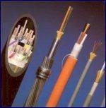

Fibre optic
connectors

Slide 25
OVERALL SUMMARY
Optical fibers carry modes of light
Step-index, GRIN, single mode & multimode
Step-index and GRIN fibers propagate light
differently
Factors that change light propagation in fibers:
    mechanical aspects (bending, tapers, etc)
    attenuation
    Dispersion
    Radiation

Slide 26
WIRELESS/ RADIATED TRNANSMISION
(UNGUIDED MEDIA)
MAINLY THREE TYPES:
1- RADIO TRANSMISSION
2- MICROWAVE TRANSMISSION
a- Terrestrial Microwave
b- Satellite Microwave
3- INFRARED TRANSMISSION

Slide 27
A Basic Wireless Communications
System Works by:
Modulating the input signal with a
suitable carrier.
Amplifying the modulated carrier wave,
Radiating it in free space with the use
of an antenna.
• A receiver tuned to the right carrier
frequency can recover the transmitted
information.
• An antenna can be used to both
transmit and receive E-M waves.

Slide 28
More on Antennas
Antennas are essential components of both the transmitter and receiver of a radio communications system.
When transmitting, the antenna radiates energy from a transmission line into free space in the desired direction.
When receiving, the antenna picks up the signals transmitted towards it.
The signals received are then guided by a transmission line (coaxial cable) to the receiver circuit for demodulation.

Slide 29
Transmission and reception
ANTENNAS CAN BE (Two Types):
A- Directional: 2GHz to 300GHz (Microwave)
  Focused beam
  Careful alignment required
  Point to point/ Point to multipoint
  Satellite
B- Omni-directional (RADIO WAVES)
  Signal spreads in all directions
  Can be received by many antenna

Slide 30
Omnidirectional: 30MHz to 1GHz
  - Broadcast radio
  - TV TRansmission
Transmitted using radio waves
Energy travels through the air rather than copper or glass
Conceptually similar to radio, TV, cellular phones
Can travel through walls and through an entire building
Can be long distance or short distance
  Long distance with satellite relay

Slide 31
Terrestrial Microwave
Typically parabolic dish, focused beam, line of sight
Max distance between T and R antenna:
  d=7.14 * Sqrt(hK) ; K=4/3,
  ; h=antenna height in meters
  ; d=distance in km
  so two 1 meter antenna can be 7.14*Sqrt(4/3)=8.2 km apart
Applications
  Long haul telecommunications, television.
  May need repeaters
  Short range (for closed-circuit TV)

Slide 32
Terrestrial Microwave
Attenuation
  Loss varies with the square of the distance
  In TP/Coax: loss varies with log of distance (linear)
  Therefore, we don’t need as many repeaters with microwave
Interference and Raindrop Attenuation
  Frequency bands strictly regulated
  Use lower frequency to avoid raindrop problem

Slide 33
Modes of Radio Wave Propagation
• Modes describe the way that E-M waves propagate in free space.
Various physical characteristics affect the E-M waves propagation in free space.
Radio waves may be:
Reflected: From the Earth's surface.
Refracted: Using upper layers of the atmosphere, to increase range beyond optical horizon.
Diffracted: This enables long to medium wave bands to propagate around obstacles.

Slide 34
Space Wave or Direct Wave
It travels in a straight line directly from transmitter antenna to receiving antenna. It is called Line of Sight (LoS) communication. These are not refracted nor they follow the curvature of earth. Because they travel in straight line they can be blocked by curvature of earth. Therefore as the distance increases height of both antennas should also increase

Slide 35
If D= distance b/w transmitter & receiver
ht= height of transmitter antenna
hr = height of receiver antenna
Distance traveled by the space wave is:
d = sqrt(2ht + 2 hr), h in feet, d in miles
If ht=150 ft, hr= 40 ft, then d= 26.22 miles
Direct Wave communication is prominent above 30Mhz (VHF, UHF, MICROWAVES). (It is the transmission mechanism for microwave radio and satellite communications). For long distance communication REPEATERS are required.

Slide 36
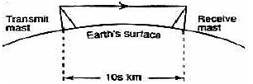

Slide 37
Ground Wave/ Surface Wave
• Transmission close to the earth's surface.
Main mechanism at VLF and MF for up to 1500 km.
Surface waves follow the earth's curvature as it guides (diffracts) them. See next slide

Slide 38
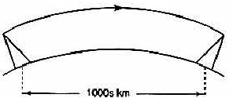
Ground waves leave the antenna and remains close to the earth and will follow the curvature of earth and can therefore travel distances beyond the horizon. GW is strongest at low and medium frequencies, 30Khz-3-Mhz. Can propagate several hundred miles. AM signals mainly propagate by ground waves. After 3Mhz, earth begins to attenuate the radio signals

Slide 39
Sky Waves is one that is radiated by the antenna into upper atmosphere where it is reflected back to earth by IONOSPHERE, 30 miles to 250 miles from earth (UV rays from SUN ionize upper atmosphere). Radio Signals are reflected to earth with minimum loss and travel extremely long distances at 3Mhz-30Mhz
e.g. AM short wave radio: SW1, SW2, SW3,……
VHF and beyond go through the ionosphere.

Slide 40
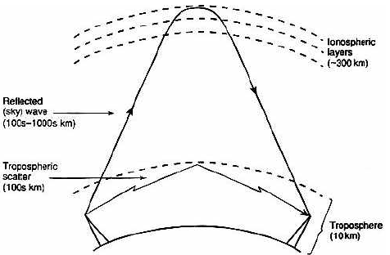
Sky Wave & Scatter

Slide 41
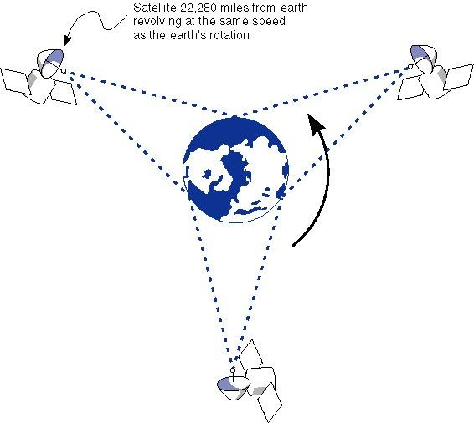
Satellite Microwave

Slide 42
Satellite is a relay station
Satellite receives on one frequency, amplifies or repeats signal and transmits on another frequency/frequencies (transponder channels)
Typically geo-stationary orbit
  Height of 35,784km or 22,236 miles
  4 degree spacing in 4/6Ghz Band (S-Band)
  3 degree spacing in 12/14 Ghz Band (KU BAND)
Applications
  TV, telephone
  Private business networks
  VSAT (Very Small Aperture Terminal)
    Large corp. with distributed sites
    Small receiver to Ku-band satellite to Big earth hub

Slide 43
Satellite Transmission Characteristics
Optimum Frequency Range 1-10Ghz
  Below 1Ghz, natural noise. Above 10Ghz, attenuation from the atmosphere
  Most applications use the 5.925-6.425 Ghz range uplink, 4.2-4.7Ghz range downlink (4/6 Ghz Band)
Propagation delay
  35784000m / 3.0 * 10⁸ m/s → 0.12 seconds
  (one way)
  About quarter second propagation delay round trip,
  (e.g. Listen News bulletin on PTV Network & PTV world)
  noticeable for phone conversations,
  problem for two-way communications
    Error /flow control?
    Low orbit satellites a solution? (LEO Sats)

Slide 44
Broadcast Radio
30Mhz to 1 Ghz (FM)
Omnidirectional
  Use loop or wire antenna instead of dish
Applications
  Range covers FM radio, UHF and VHF television
Due to lower frequencies than microwave, less problems with attenuation
Same equation for antenna distance, attenuation as microwave
Drawbacks
  Suffers from multipath interference, Reflections
  Possible security concerns

Slide 45
INFRARED
Infrared light transmission through air.
Similar to technology used in TV remote
control
Can propagate throughout a room
(bouncing off surfaces),
will not penetrate walls / Blocked by walls.
Line of sight (or reflection)
Low speed, 1-4 Mbps
Short range, 50-75 feet maximum
Remote control, IRD port (PC), networking Hubs etc

Slide 46
Infrared

Slide 47
  LASER
  Unidirectional, like microwave
  Higher speed than microwave
  Uses laser transmitter and photo-sensitive receiver at each end
    Point-to-point, typically between buildings
    Can be adversely affected by weather

Slide 48
  Choosing a medium
  Copper wire is mature technology, rugged and inexpensive; maximum transmission speed is limited
  Glass fiber:
    Higher speed
    Resistant to electro-magnetic interference
    Spans longer distances
    More expensive

Slide 49
  Choosing a medium
  Radio, microwave, infrared
  don't require physical
  connection
  Radio/ infrared may be
  used for mobile connections
  Laser does not need
  physical connection/
  supports higher speeds

Slide 50
Guided Media
Network Transmission Error
Media Type Cost Distance Security Rates Speed
Twisted Pair LAN Low Short Good Low Low-high
Coaxial Cable LAN Mod. Short-Mod Good Low Low-high
Fiber Optics any High Mod.-long V. Good V-Low High-V-High
Radiated Media
Network Transmission Error
Media Type Cost Distance Security Rates Speed
Radio (FM) LAN Low Short Poor Mod Low
Infrared LAN Low Short Poor Mod Low
Microwave WAN Mod Long Poor Low-Mod Mod
Satellite WAN Mod Long Poor Low-Mod Mod

